Slide 1


Slide 2
TYPES OF INHERITANCE
Click here to add a subtitle
SINGLE
MULTILEVEL
HYBRID
HIRARCHICAL
01
02
03
04

Slide 3
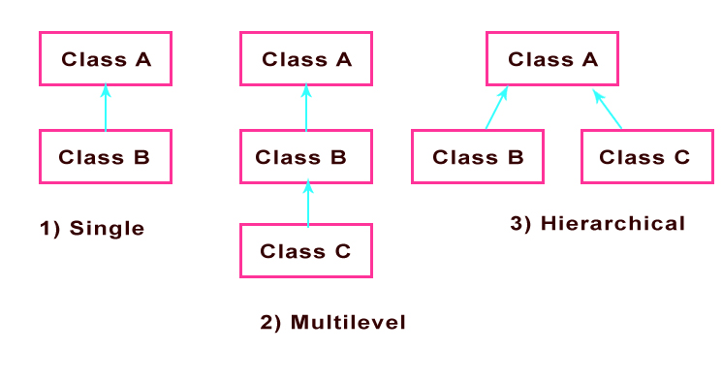
Click here to add the title

Slide 4
SINGLE INHERITANCE
class Parent {
constructor(name) {
this.name = name;
}
greet() {
console.log(`Hello, my name is ${this.name}.`);
}
}
class Child extends Parent {
// No additional methods or properties in this example
}
// Creating an instance of Child
const child = new Child("Bob");
// Calling methods from the Parent class
child.greet();

Slide 5
MULTILEVEL INHERITANCE
class A {
methodA() {
console.log("This is method A from class A");
}
}
class B extends A {
methodB() {
console.log("This is method B from class B");
}
}
class C extends B {
methodC() {
console.log("This is method C from class C");
}
}
// Creating an instance of class C
const obj = new C();
// Calling methods from different classes
obj.methodA();
obj.methodB();
obj.methodC();
.

Slide 6
hybrid inheritance
// Base class 1
class Animal {
constructor(name) {
this.name = name;
} makeSound() {
console.log("Generic animal sound");
}
}
// Base class 2
class Vehicle {
constructor(type) {this.type = type}
startEngine() {
console.log("Engine started");
}}
// Derived class combining features of Animal and Vehicle
class HybridEntity extends Animal {
constructor(name, type) {
super(name);
this.vehicle = new Vehicle(type);
}
startEngine() {
this.vehicle.startEngine();
}}
// Creating an instance of the HybridEntity
const hybrid = new HybridEntity("Leo", "Car");
// Using methods from both Animal and Vehicle classes
hybrid.makeSound();
hybrid.startEngine();

Slide 7
class baba{
constructor(n){
// console.log("baba hun me ")
this.name = n
}}
class beta extends baba{
constructor(p,d){
super(p)
this.department = d
}
}
let beta1 = new beta("humaira" , "Bscs");
console.log(beta1);

Slide 8
class baba{
constructor(n){
// console.log("baba hun me ")
this.name = n
}
msg(){
console.log("there is msg of baba");
}
}
class beta extends baba{
constructor(p,d){
super(p)
this.department = d
}
info(){
this.msg();
console.log(this.name + " is manger of departmnet " + this.department)
}
msg(){
console.log("there is msg of beta");
}
}
let beta1 = new beta("humaira" , "Bscs");
console.log(beta1.info());

